Slide 1
We provide the best logistics services.

Slide 2
GREETING
Thank you for interesting in RIS Logistics LLC.
In the logistics field where the demand for logistics continues to increase in recent years,
we are building an efficient system to deliver "products smoothly, at the required timing,
to the required place, and in the required quantity" to customers.
In the midst of chaotic economic and logistics conditions, we promise to provide logistics services that are close to our customers from the customer's point of view.
Please feel free to contact us first.
ABOUT RIS Logistics
Company Name：RIS Logistics LLC
Establishment：2020, May
CEO：Isamu Sato
Head Office：2-2-15 Minami Aoyama Minato-Ku Tokyo 107-0062 Japan
TEL：+81-3-6403-4201

Slide 3
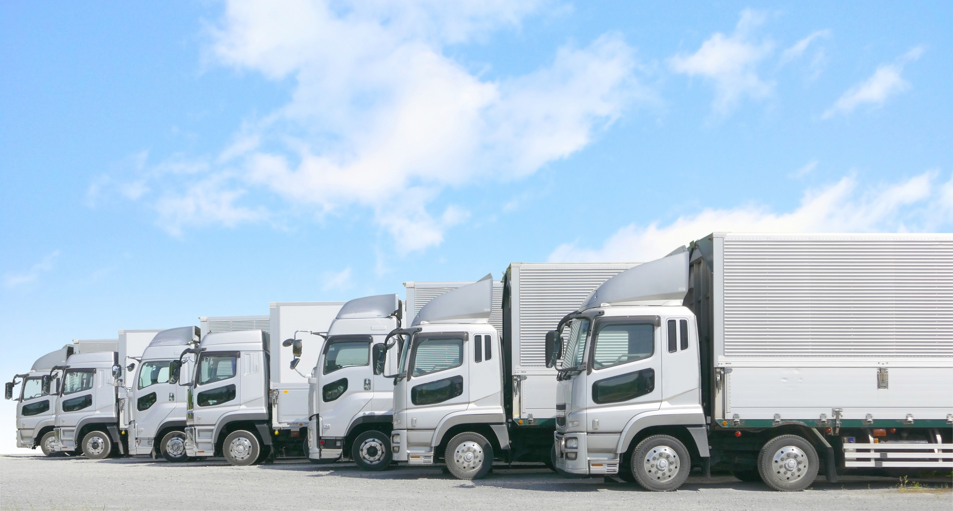
3 benefits of using RIS
①Optimization of logistics
We will manage logistics on behalf of our customers. If you ask us, we will propose the best logistics.
②Unification of contact points
The contact point in charge changes for each business, and there are many inquiries, so there is no hassle. At RIS, our dedicated staff will respond from quotation to billing.
③Speed of response
Our first motto is speed. We will respond to inquiries from customers instantly.
We will respond to your request for quotation in as little as 10 minutes.

Slide 4
SERVICE
・Forwarding Service
We provide safe, reliable, high-quality transportation of LCL cargo, FCL cargo, air cargo, courier, trilateral cargo, and specialty cargo to/from Southeast Asian, North America, Latin America, the Middle East, and Europe. We propose the best transportation method that meets the needs of our customers.
・Customs House Brokerage
We will promptly respond to complicated customs clearance and incidental work on behalf of the customer. We will sincerely address concerns such as "changing customs brokers and increasing the number of questions" and provide services that do not cause stress to customers.

Slide 5
・Cargo pick-up and delivery
We use trucks and container haulage to provide pickup and delivery services based at ports and airports. In addition, for trucks, we can respond quickly and flexibly to cargo other than cargo departing from and arriving at ports and airports.
・Project Cargo
We carry in and install all kinds of heavy and precision equipment, such as semiconductor-related equipment, medical equipment, printing equipment, and machine tools, to designated locations. We never neglect careful safety checks along with work arrangements.
・Warehousing
We accept your important cargo from a small package.
We also accept individual shipments of stored cargo.

Slide 6
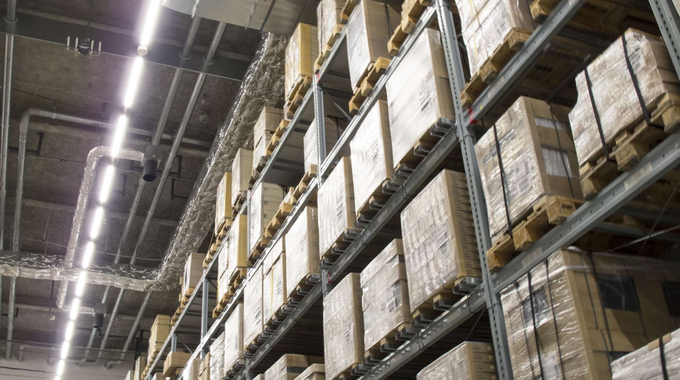
・Stuffing & Unstuffing Service
We undertake stuffing & unstuffing work for various packing forms.
We can handle from carton cargo to heavy cargo.
・Packing Service
We arrange packaging according to customer needs, from small cargo to large equipment and machinery. In addition to reducing the risk of damage during transportation, it also realizes cost-effective packaging by reducing weight and compactness.

Slide 7
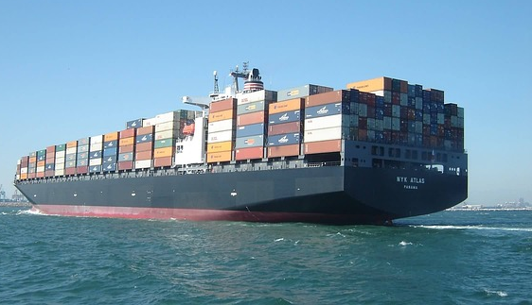
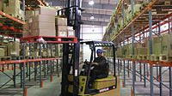
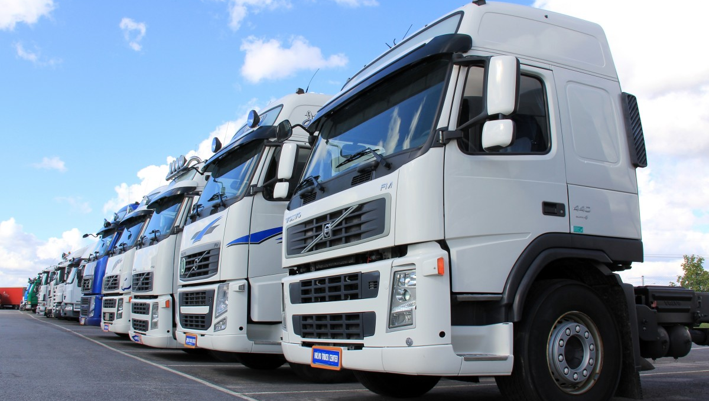
Any inquiry, please contact
Mr. Isamu Sato
i.sato@rislogi.com
THANK YOU・・・
この写真 の作成者 不明な作成者 は CC BY-SA のライセンスを許諾されています

